Slide 1
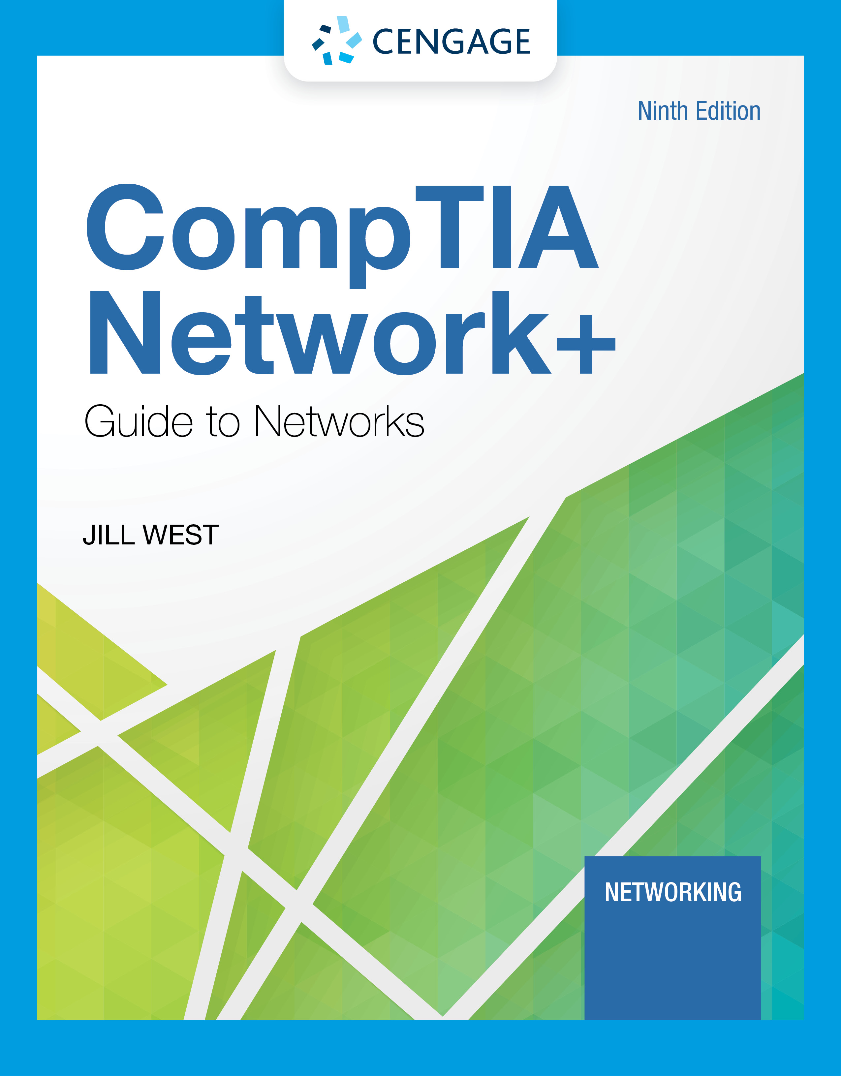
Module 1: Introduction to Networking
CompTIA Network+ Guide to Networks, Ninth Edition

Slide 2
Module Objectives
By the end of this module, you should be able to:
1. Distinguish between peer-to-peer and client-server networks
2. Identify types of applications and protocols used on a network
3. Describe various networking hardware devices and the most common physical topologies
4. Describe the seven layers of the OSI model
5. Explain best practices for safety when working with networks and computers
6. Describe the seven-step troubleshooting model for troubleshooting network problems

Slide 3
Network Models
Topology describes how parts of a whole work together
Physical topology mostly refers to a network’s hardware and how computers, other devices, and cables work together to form the physical network
Logical topology refers to how software controls access to network resources
It includes how users and software initially gain access to the network
A network operating system (NOS) controls access to the entire network
A NOS is required by client-server models

Slide 4
Peer-to-Peer Network Model (1 of 2)
In a peer-to-peer (P2P) network model the OS of each computer on the network is responsible for controlling access to its resources
There is no centralized control
Computers, called nodes or hosts, form a logical group of computers and users
Each computer controls its own administration, resources, and security
Advantages
Simple configuration
Less expensive compared to other network models
Disadvantages
Not scalable
Not necessarily secure
Not practical for large installations

Slide 5
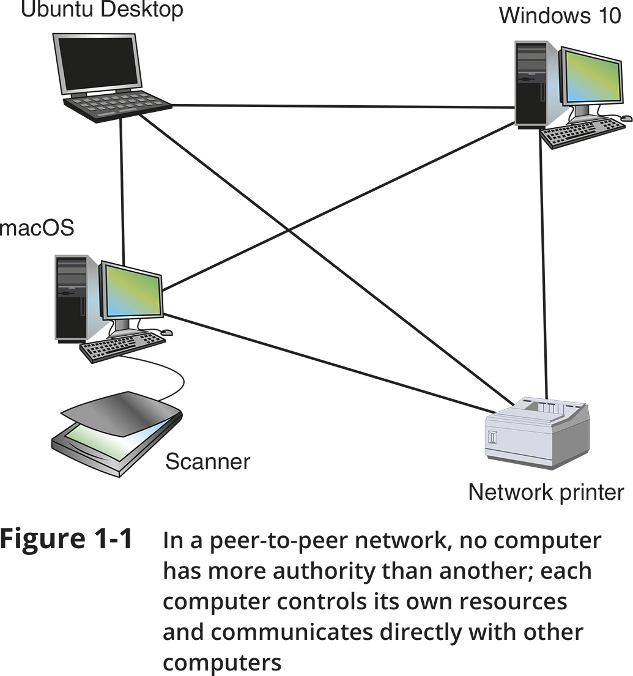
Peer-to-Peer Network Model (2 of 2)
Figure 1-1 In a peer-to-peer network, no computer has more authority than another; each computer controls its own resources and communicates directly with other computers

Slide 6
Client-Server Network Model (1 of 3)
Resources are managed by the NOS via a centralized directory database
A Windows domain is a logical group of computers that a Windows Server can control
Active Directory (AD) is the centralized directory database that contains user account information and security for the entire group of computers
A user can sign on to the network from any computer on the network and gain access to the resources that AD allows
This process is managed by Active Directory Domain Services (AD DS)
A computer making a request from another is called the client

Slide 7
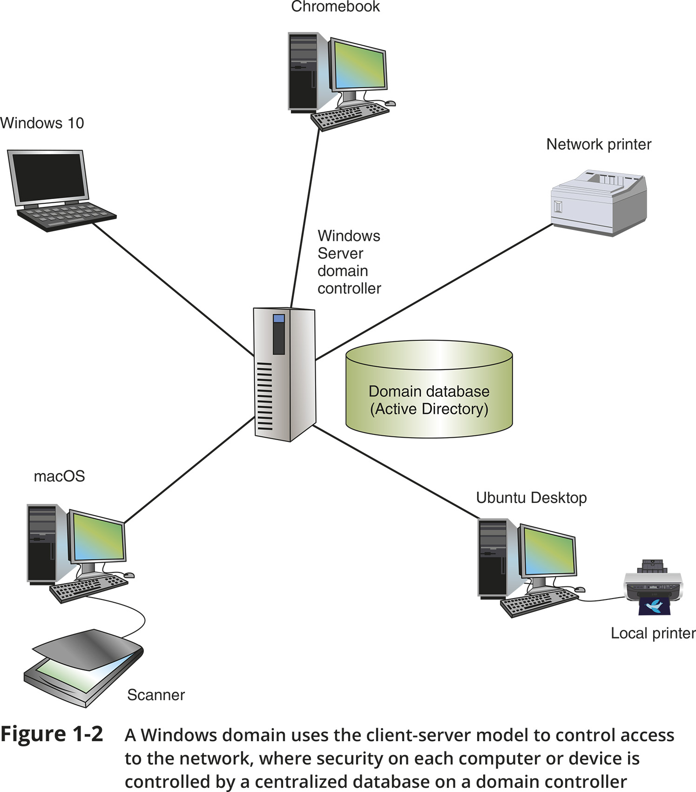
Client-Server Network Model (2 of 3)
Figure 1-2 A Windows domain uses the client-server model to control access to the network, where security on each computer or device is controlled by a centralized database on a domain controller

Slide 8
Client-Server Network Model (3 of 3)
The NOS is responsible for:
Managing client data and other resources
Ensuring authorized user access
Controlling user file access
Restricting user network access
Dictating computer communication rules
Supplying applications and data files to clients
Servers that have a NOS installed require:
More memory, processing power, and storage capacity
Equipped with special hardware to provide network management functions

Slide 9
Client-Server Applications (1 of 2)
Network services are the resources a network makes available to its users
It includes applications and the data provided by these applications
In client-server applications:
A client computer requests data or a service from a second computer, called the server

Slide 10
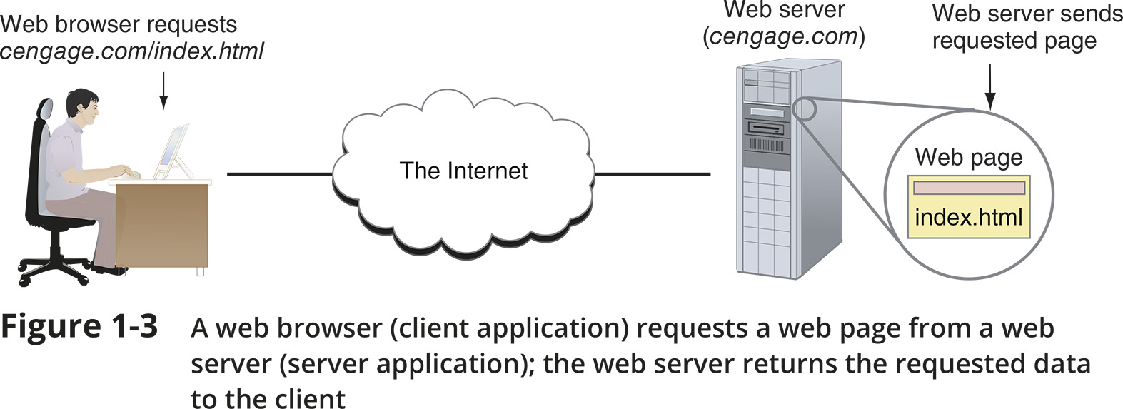
Client-Server Applications (2 of 2)
Figure 1-3 A web browser (client application) requests a web page from a web server (server application); the web server returns the requested data to the client

Slide 11
Network Services and Their Protocols (1 of 2)
Protocols are methods and rules for communication between networked devices
Two primary network protocols:
TCP (Transmission Control Protocol)
IP (Internet Protocol)
Popular client-server applications include:
Web service
Email services
DNS service
FTP service
Database services
Remote access service

Slide 12
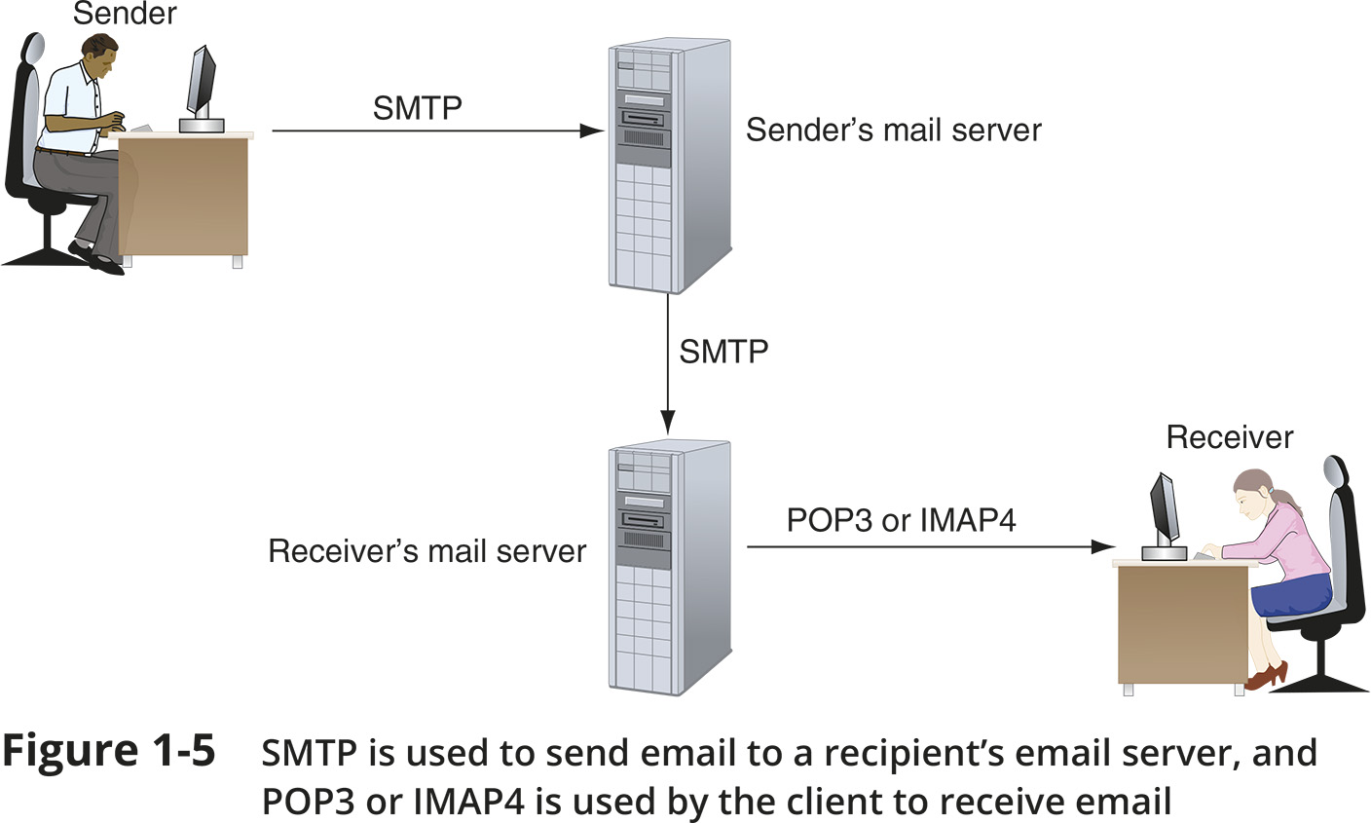
Network Services and Their Protocols (2 of 2)
Figure 1-5 SMTP is used to send email to a recipient’s email server, and POP3 or IMAP4 is used by the client to receive email

Slide 13
Knowledge Check Activity 1-1
Which of these protocols could not be used to access a server in a nearby building?
Telnet
RDP
TLS
SSH
Notes:
Instructions:
Net+: you will choose two of the Self-Check questions from each module and re-use them for Knowledge Check Activities. The activity numbers change based on the module you are in. (e.g., 1-1 and 1-2; 2-1 and 2-2; etc.) The CM will provide you with the final page proofs from the textbook.

Slide 14
Knowledge Check Activity 1-1: Answer
Which of these protocols could not be used to access a server in a nearby building?
Answer: c. TLS
TLS (Transport Layer Security) adds encryption to other protocols, such as HTTP, but does not provide remote access to a computer
Notes:
Include only the question and the correct answer on the slide or include only the correct answer on the slide. The CM will provide you with the Solution and Answer Guide for the correct answers.

Slide 15
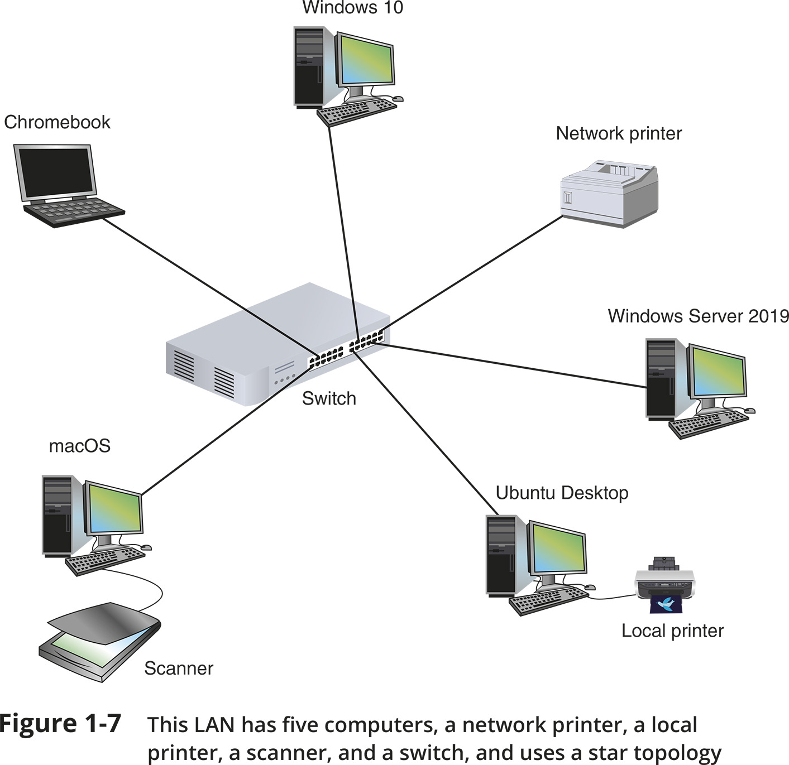
Network Hardware
Figure 1-7 This LAN has five computers, a network printer, a local printer, a scanner, and a switch, and uses a star topology

Slide 16
LANs and Their Hardware (1 of 4)
A LAN (local area network) is usually contained in a small space
A switch receives incoming data from one of its ports and redirects it to another port or multiple ports
Will send the data to its intended destination
The physical topology used by this network is called a star topology
All devices connect to one central device (usually a switch)
A NIC (network interface card) is a network port used to attach a device to a network
Also called a network adapter
A LAN can have several switches
A backbone is a central conduit that connects the segments (pieces) of a network

Slide 17
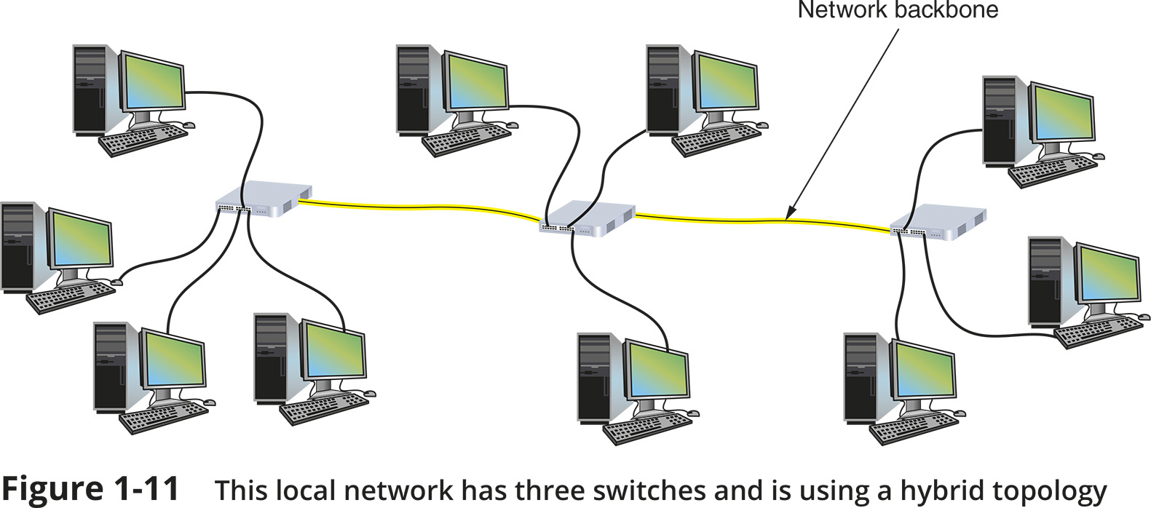
LANs and Their Hardware (2 of 4)
Figure 1-11 This local network has three switches and is using a hybrid topology

Slide 18
LANs and Their Hardware (3 of 4)
A router is a device that manages traffic between two or more networks
Can help find the best path for traffic to get from one network to another
Routers can be used in small home networks to connect the home LAN to the Internet
Called a SOHO (small office-home office) network
Industrial-grade routers can have several network ports, one for each network it connects to
Difference between router and switch:
A router is like a gateway between networks and belongs to two or more local networks
A switch belongs only to its local network

Slide 19
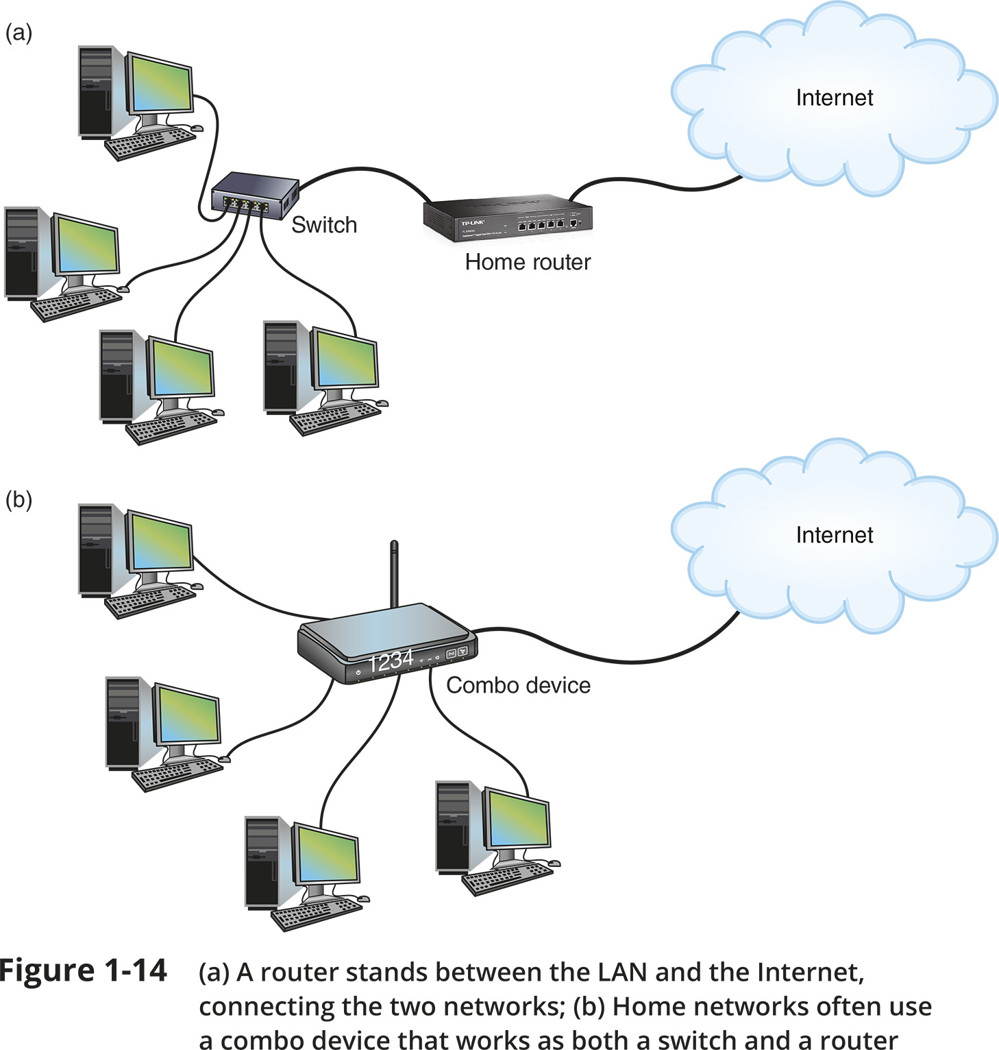
LANs and Their Hardware (4 of 4)
Figure 1-14 (a) A router stands between the LAN and the Internet, connecting the two networks; (b) Home networks often use a combo device that works as both a switch and a router

Slide 20
MANs and WANs (1 of 2)
A WAN (wide area network) is a group of LANs that spread over a wide geographical area
A MAN (metropolitan area network) is a group of connected LANs in the same geographical area
Also known as a campus area network (CAN)
MANs and WANs often use different transmission methods and media than LANs
PAN (personal area network) is a much smaller network of personal devices
A network of personal devices such as your smartphone and your computer
Other network types:
BAN (body area network)
SAN (storage area network)
WLAN (wireless local area network)

Slide 21
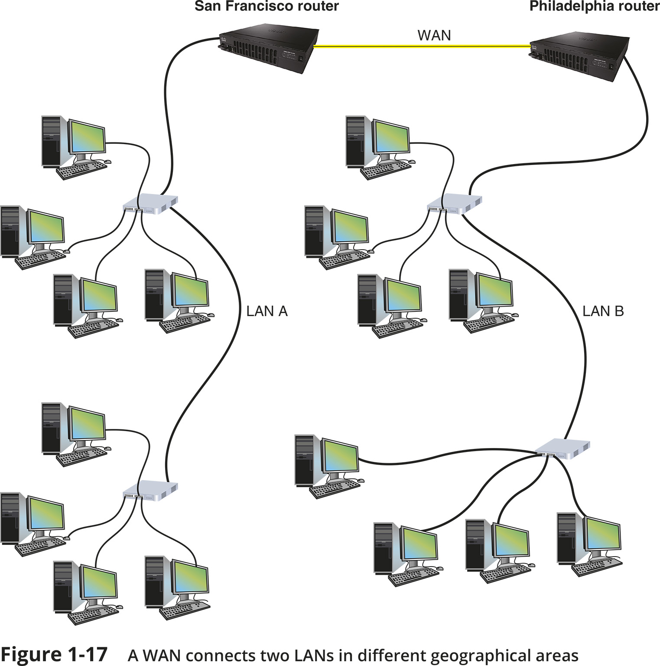
MANs and WANs (2 of 2)
Figure 1-17 A WAN connects two LANS in different geographical areas

Slide 22
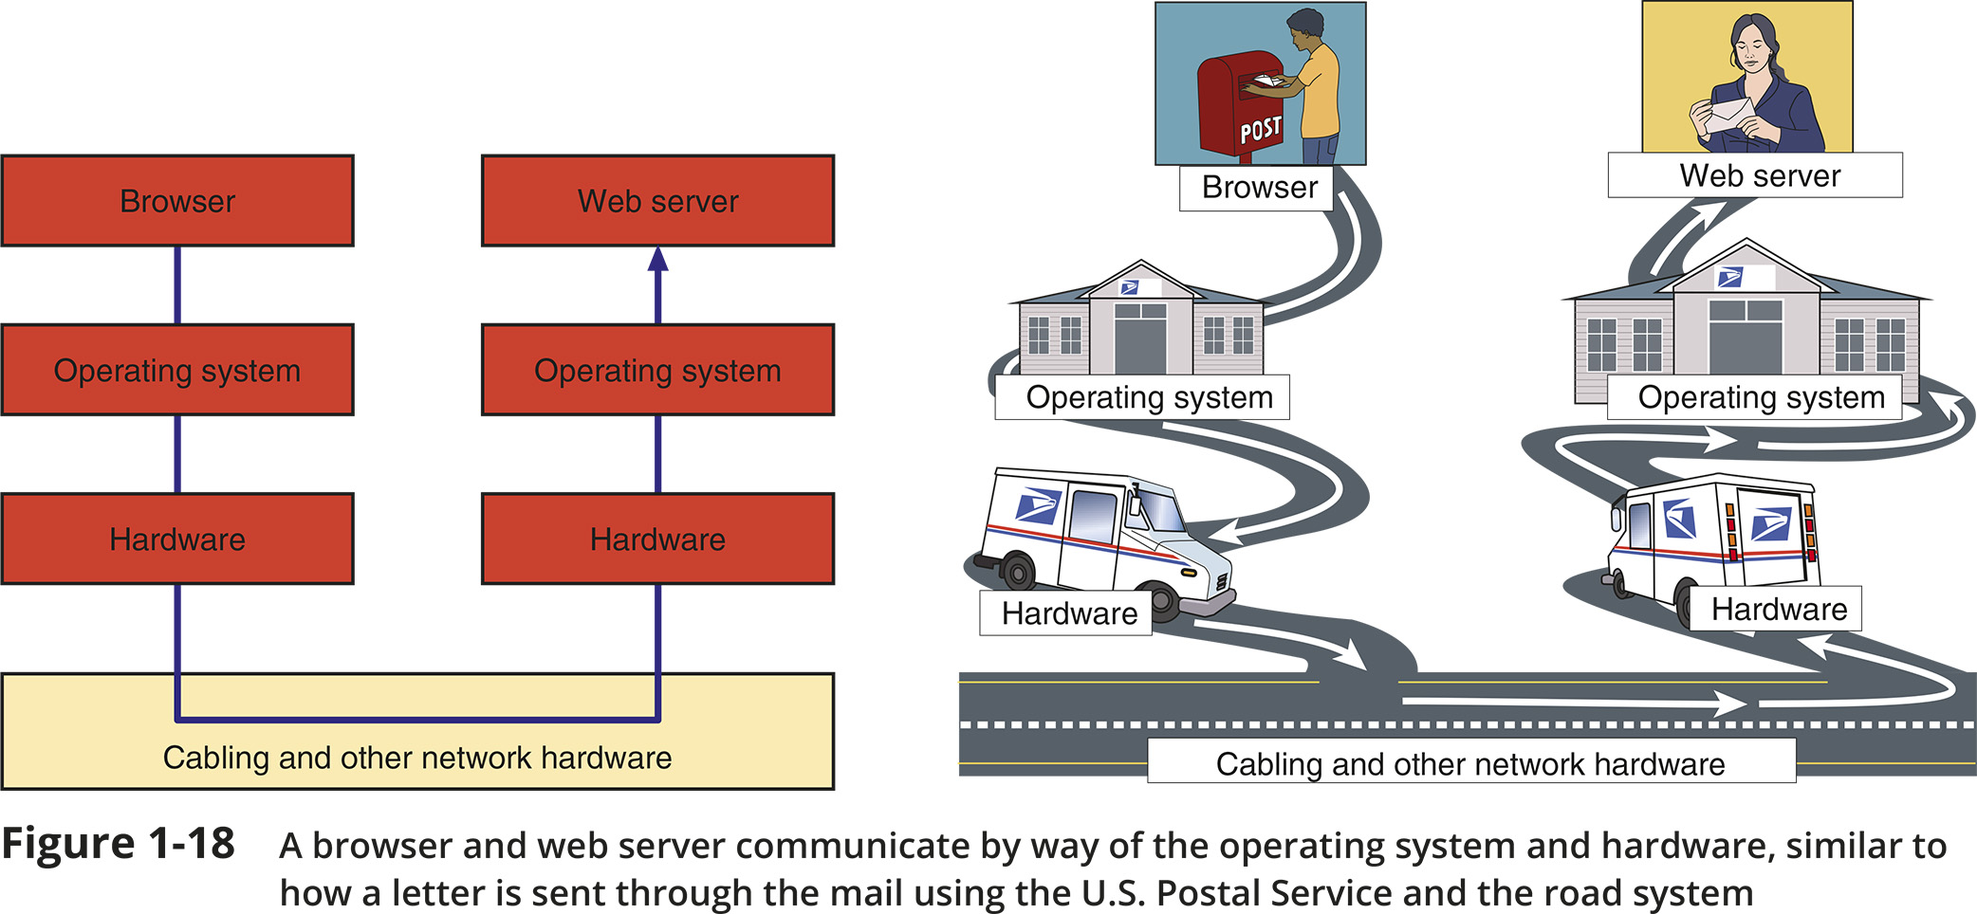
The Seven-Layer OSI Model (1 of 2)
Figure 1-18 A browser and web server communicate by way of the operating system and hardware, similar to how a letter is sent through the mail using the U.S. Postal Service and the road system

Slide 23
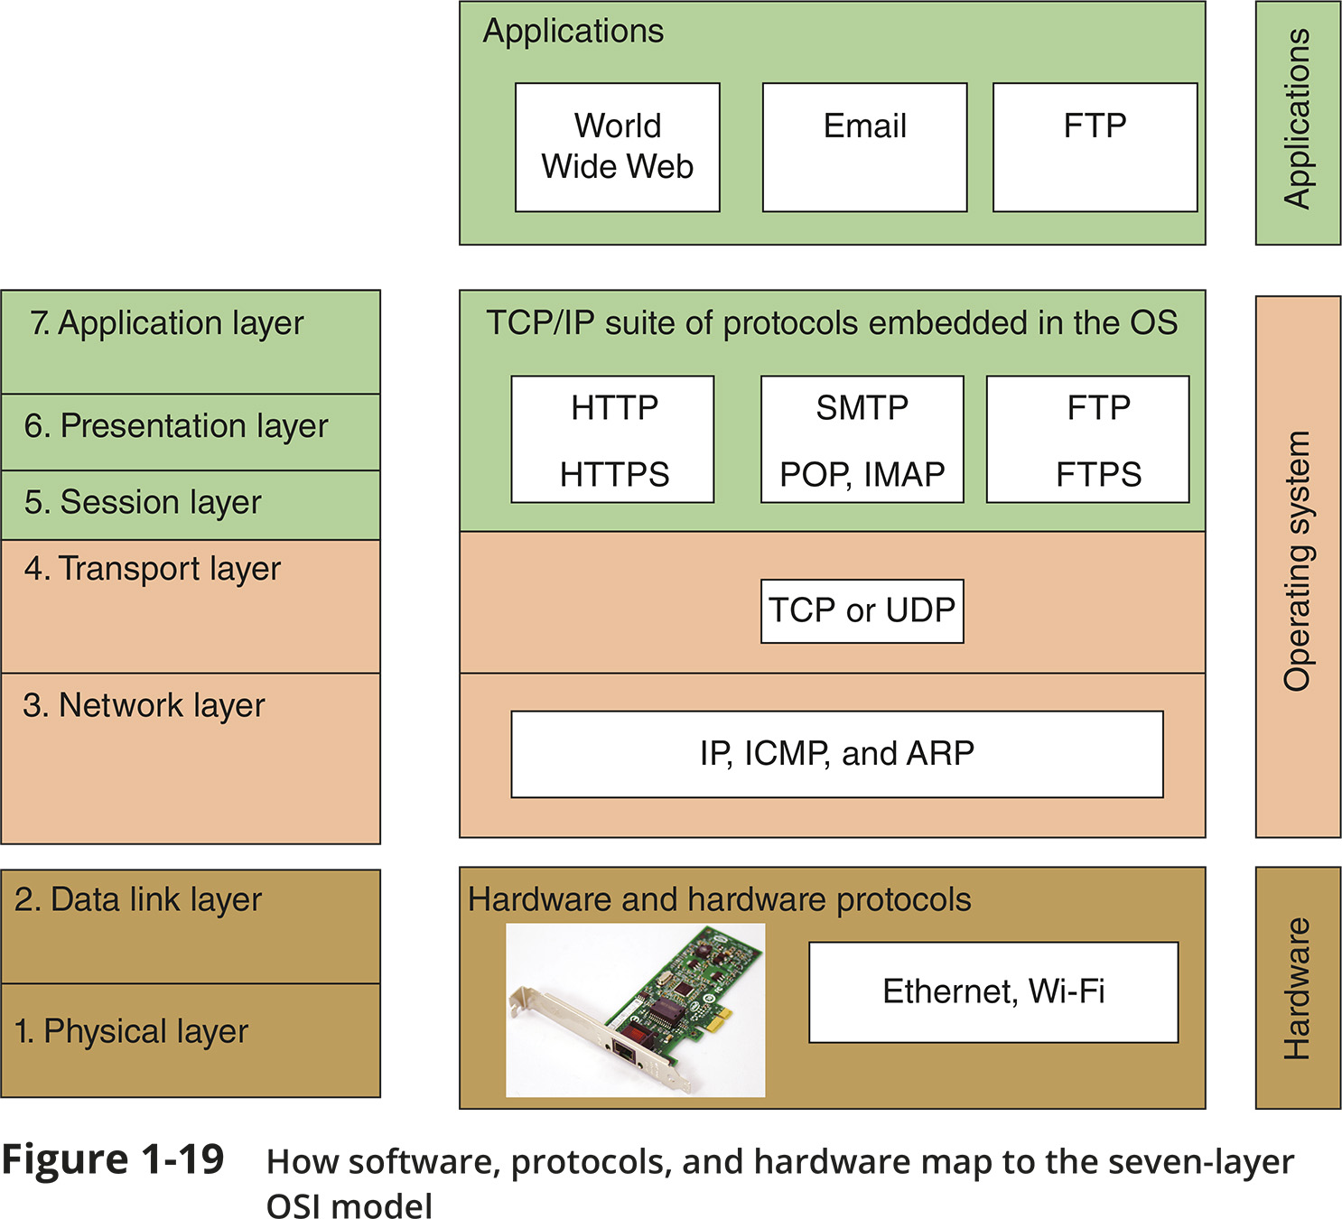
The Seven-Layer OSI Model (2 of 2)
Figure 1-19 How software, protocols, and hardware map to the seven-layer OSI model

Slide 24
Layer 7: Application Layer
The application layer describes the interface between two applications, on separate computers
Application layer protocols are used by programs that fall into two categories:
Provide services to a user, such as a browser and Web server
Utility programs that provide services to the system, such as SNMP (Simple Network Management Protocol) programs that monitor and gather information about network traffic
Payload is the data that is passed between applications or utility programs and the OS

Slide 25
Layer 6: Presentation Layer
The presentation layer is responsible for reformatting, compressing, and/or encrypting data in a way that the receiving application can read
Example:
An email message can be encrypted at the Presentation layer by the email client or by the OS

Slide 26
Layer 5: Session Layer
The session layer describes how data between applications is synched and recovered if messages don’t arrive intact at the receiving application
The application, presentation, and session layers are intertwined
It is often difficult to distinguish between them
Most tasks are performed by the OS when an application makes an API call to the OS
An API (application programming interface) call is the method an application uses when it makes a request of the OS

Slide 27
Layer 4: Transport Layer
The transport layer is responsible for transporting Application layer payloads from one application to another
Two main Transport layer protocols are:
TCP (Transmission Control Protocol) - makes a connection with the end host, checks whether data was received; called a connection-oriented protocol
UDP (User Datagram Protocol) - does not guarantee delivery by first connecting and checking whether data is received; called a connectionless protocol
Protocols add control information in an area at the beginning of the payload (called header)
Encapsulation is the process of adding a header to the data inherited from the layer above
The Transport layer header addresses the receiving application by a number called a port
If a message is too large, TCP divides it into smaller messages called segments
In UDP, the message is called a datagram

Slide 28
Layer 3: Network Layer
The network layer is responsible for moving messages from one node to another until they reach the destination host
The principal protocol used by this layer is IP (Internet Protocol)
IP adds its own network layer header to the segment or datagram
The entire network layer message is called a packet
An IP address is an address assigned to each node on a network
The network layer uses it to uniquely identify each host
IP relies on several routing protocols to find the best route for a packet to take to reach destination
ICMP and ARP are examples
Network layer protocol will divide large packets into smaller packets in a process called fragmentation

Slide 29
Layer 2: Data Link Layer
Layers 2 and 1 are responsible for interfacing with physical hardware on the local network
Protocols at these layers are programmed into firmware of a computer’s NIC and other hardware
Type of networking hardware or technology used on a network determine the data link layer protocol used
Ethernet and Wi-Fi are examples
The data link layer puts control information in a data link layer header and at the end of the packet in a trailer
The entire data link layer message is called a frame
A MAC (Media Access Control) address is also called a physical address, hardware address, or data link layer address
It is embedded on every network adapter

Slide 30
Layer 1: Physical Layer
The physical layer is responsible for sending bits via a wired or wireless transmission
Bits can be transmitted as:
Wavelengths in the air
Voltage on a copper wire
Light (via fiber-optic cabling)

Slide 31
Protocol Data Unit or PDU
Protocol data unit (PDU) is the technical name for a group of bits as it moves from one layer to the next and from one LAN to the next
Technicians loosely call this group of bits a message or a transmission

Slide 32
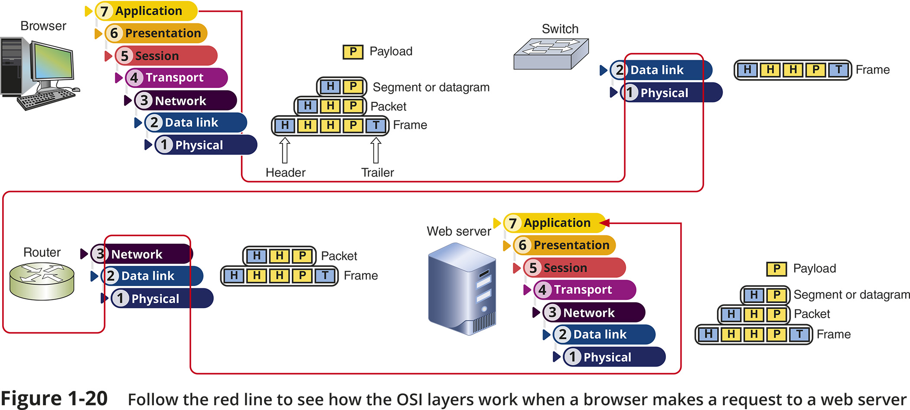
Summary of How the Layers Work Together
Figure 1-20 Follow the red line to see how the OSI layers work when a browser makes a request to a web server

Slide 33
Knowledge Check Activity 1-2
Which OSI layer adds both a header and a trailer?
Transport layer
Network layer
Data link layer
Physical layer
Notes:
Instructions:
Net+: you will choose two of the Self-Check questions from each module and re-use them for Knowledge Check Activities. The activity numbers change based on the module you are in. (e.g., 1-1 and 1-2; 2-1 and 2-2; etc.) The CM will provide you with the final page proofs from the textbook.

Slide 34
Knowledge Check Activity 1-2: Answer
Which OSI layer adds both a header and a trailer?
Answer: c. Data link layer
The data link layer puts its control information in a data link layer header and also attaches control information to the end of the packet in a trailer
Notes:
Include only the question and the correct answer on the slide or include only the correct answer on the slide. The CM will provide you with the Solution and Answer Guide for the correct answers.

Slide 35
Safety Procedures and Policies
Network and computer technicians need to know how to protect themselves
As wells as protect sensitive electronic components
This section takes a look at some best practices for safety

Slide 36
Emergency Procedures
Know the best escape route or emergency exit
Fire Suppression Systems - have a fire suppression system in the data center that includes:
Emergency alert system
Portable fire extinguishers
Emergency power-off switch
Ask yourself: Does the security system allow access during a failure (fail open) or deny access during the failure (fail close)?
An SDS (safety data sheet) explains how to properly handle substances such as chemical solvents and how to dispose of them
Includes information such as identification, first-aid measures, fire-fighting measures, accidental release measures, handling and storage guidelines, exposure controls, and physical and chemical properties

Slide 37
Safety Procedures (1 of 4)
Electrical and tool safety is generally regulated by OSHA (Occupational Safety and Health Administration)
OSHA guidelines when using power tools:
Wear PPE (personal protective equipment)
Keep all tools in good condition and properly store tools not in use
Use the right tool for the job and operate the tool according to the manufacturer’s instructions
Watch out for trip hazards, so you and others don’t stumble on a tool or cord

Slide 38
Safety Procedures (2 of 4)
Lifting Heavy Objects - follow these guidelines:
Decide which side of object to face so load is most balanced
Stand close to the object with your feet apart
Keep your back straight, bend knees and grip load
Lift with your legs, arms, and shoulders (not your back or stomach)
Keep the load close to your body and avoid twisting your body while you’re holding it
To put the object down, keep your back as straight as possible and lower object by bending your knees

Slide 39
Safety Procedures (3 of 4)
Protecting Against Static Electricity
Computer components are grounded inside a computer case
Grounding means that a device is connected directly to the earth
Sensitive electronic components can be damaged by ESD (electrostatic discharge)
Static electricity can cause two types of damage:
Catastrophic failure - destroyed beyond use
Upset failure - shorten the life of a component

Slide 40
Safety Procedures (4 of 4)
Before touching a component, ground yourself by:
Wearing an ESD strap around your wrist that clips onto the chassis or computer case
Touching the case before touching any component inside the case
Storing a component inside an antistatic bag
In addition to protecting against ESD, always shut down and unplug a computer before working inside it

Slide 41
Troubleshooting Network Problems
Troubleshooting steps used by most expert networking troubleshooters:
Step 1: Identify the problem and its symptoms
Step 2: Establish theory of probable cause
Step 3: Test your theory to determine cause
Step 4: Establish a plan for resolving the problem
Step 5: Implement the solution or escalate the problem
Step 6: Verify full functionality and implement preventative measures
Step 7: Document findings, actions, outcomes

Slide 42
Self-Assessment
What networking hardware devices have you used in the past?
What type of network or computer safety issues have you (or a friend or another student) experienced? How did you troubleshoot those issues?
Notes:
Instructions:
Create a question(s) aligned with the learning objectives at the beginning of the module. Form questions based on the LOs for the module so that students can evaluate their progress on the goals for the course.
Try to form a question(s) that asks students to apply some of the knowledge they learned from this module and connects that knowledge to a personal experience they have had, an experience in school, a professional memory, etc.

Slide 43
Summary
Now that the lesson has ended, you should be able to:
Distinguish between peer-to-peer and client-server networks
Identify types of applications and protocols used on a network
Describe various networking hardware devices and the most common physical topologies
Describe the seven layers of the OSI model
Explain best practices for safety when working with networks and computers
Describe the seven-step troubleshooting model for troubleshooting network problems

